Slide 1
Features
SE499: Software Design & Development Project

Slide 2
Understanding Software Architecture
Software architecture is the high-level structure and organization of a software system.
It is the foundation upon which all other software elements, components, and interactions are built.
The software architecture defines the essential building blocks, their relationships, and the overall design principles that govern how the system functions and evolves over time.

Slide 3
The Four Dimensions of Architecture
Structure
Architecture Characteristics
Architectural Decisions
Design Principle

Slide 4
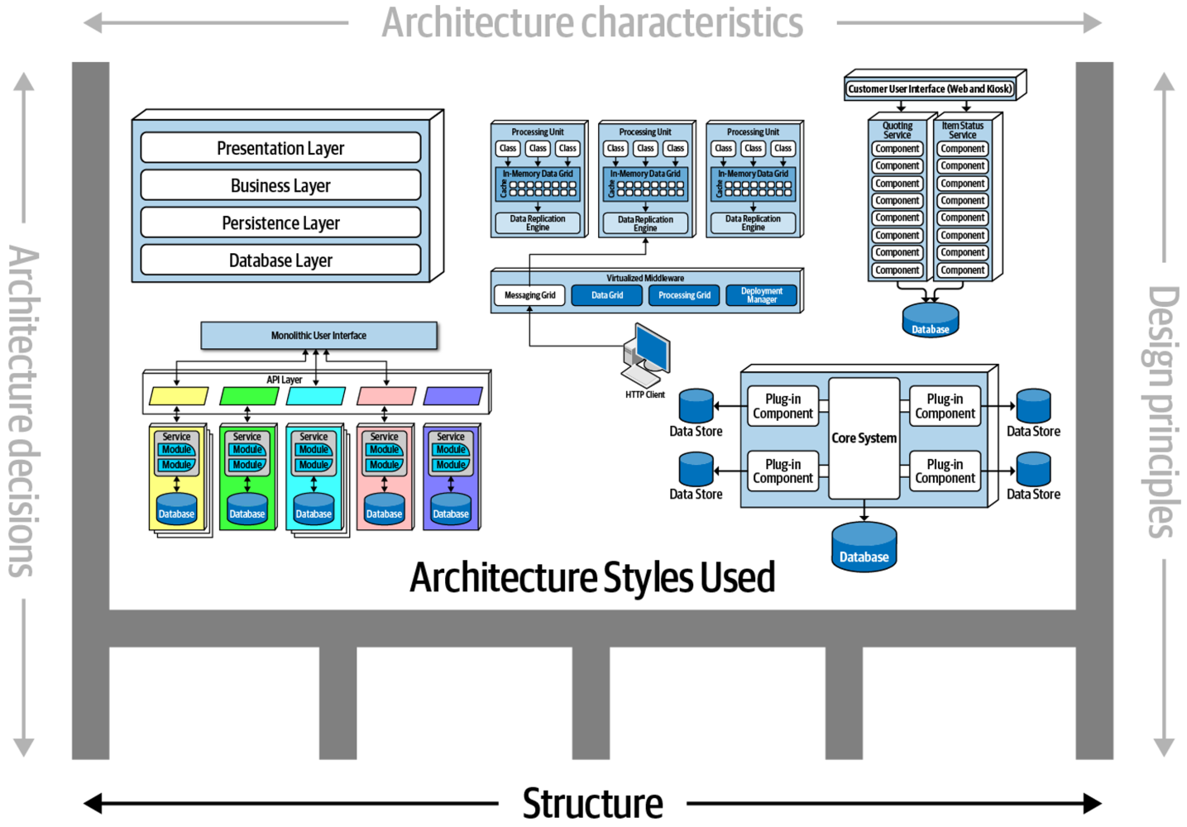

Slide 5
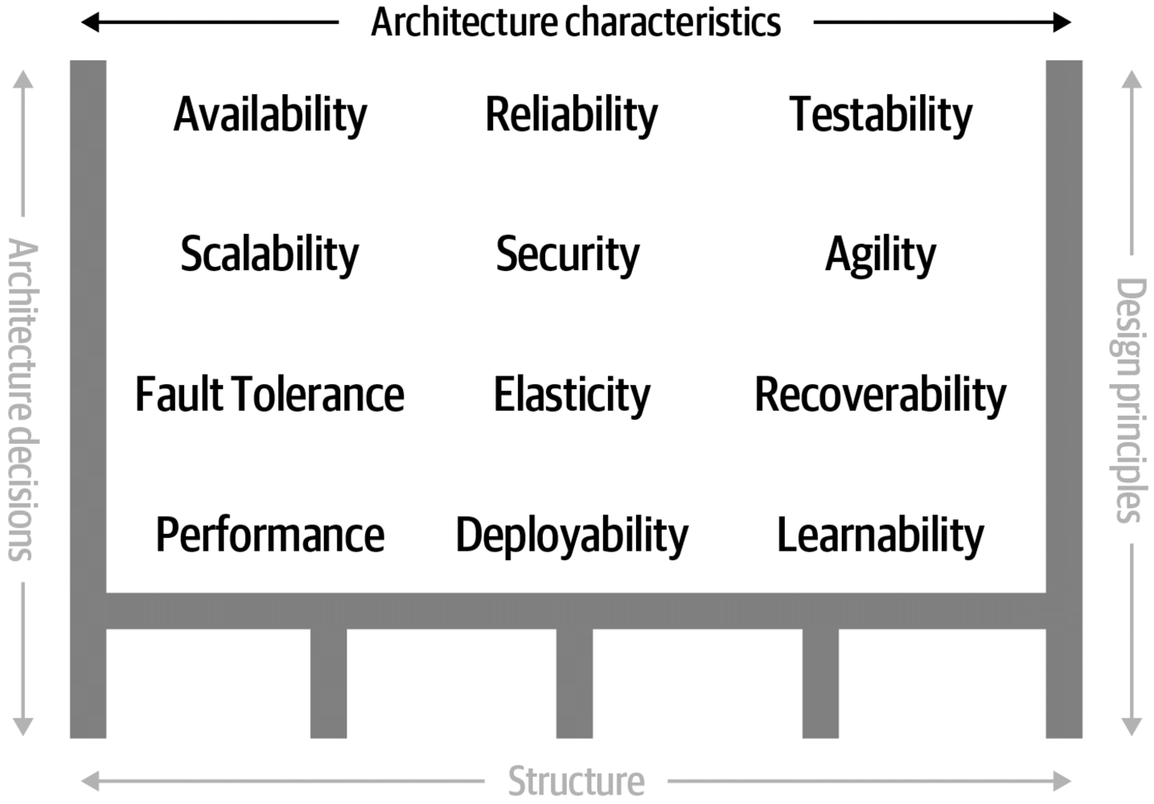

Slide 6
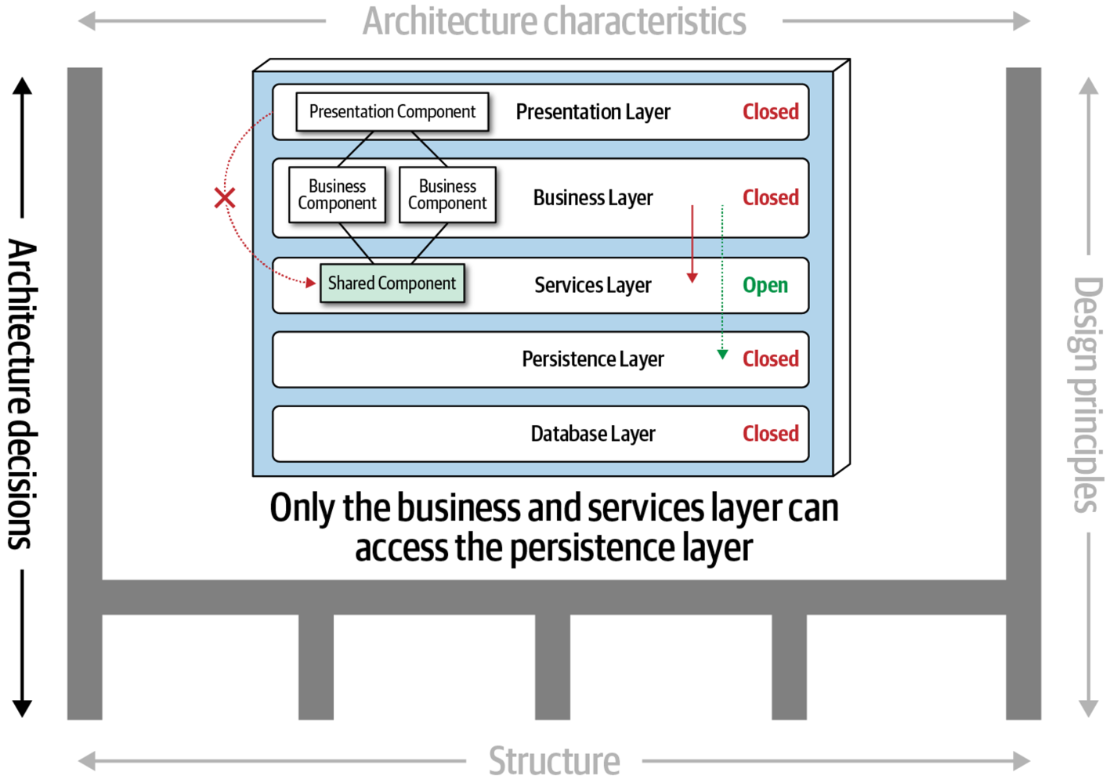

Slide 7
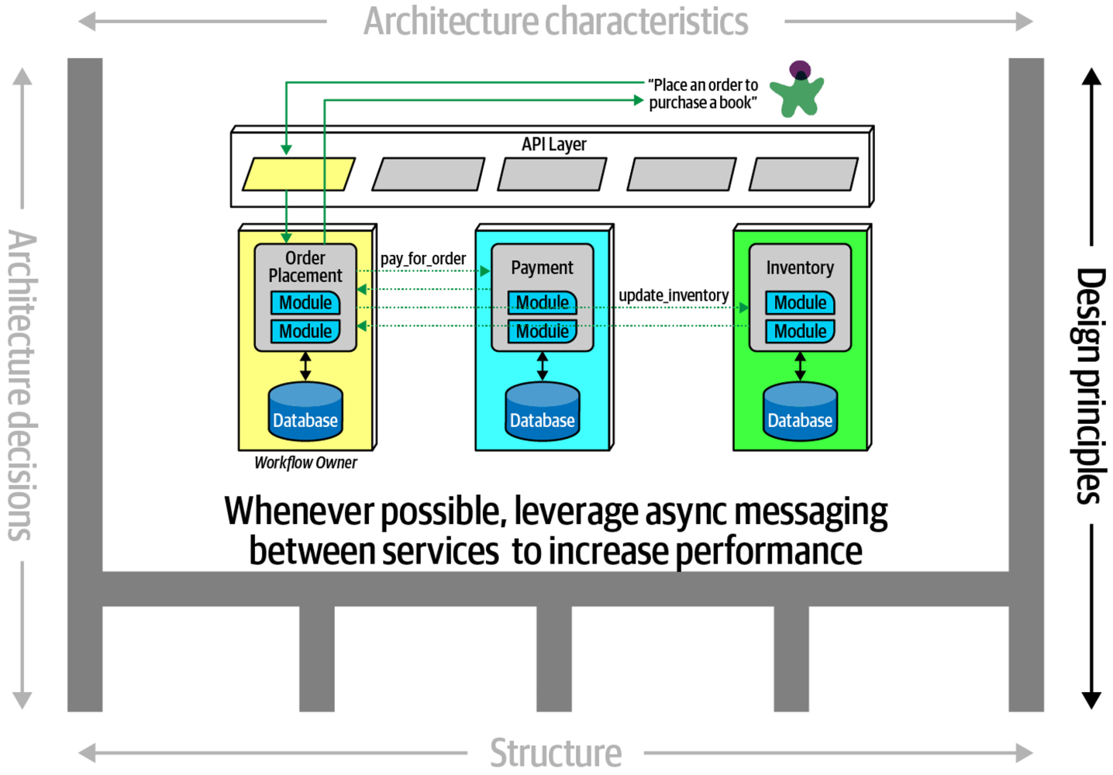

Slide 8
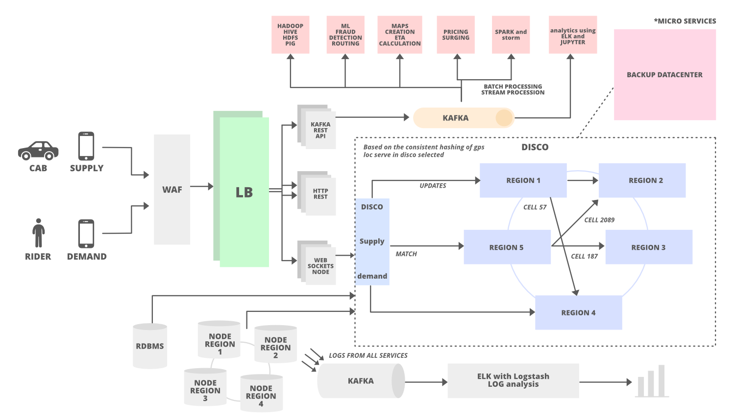

Slide 9
Software products
There are three factors that drive the design of software products
Business and consumer needs that are not met by current products
Dissatisfaction with existing business or consumer software products
Changes in technology that make completely new types of product possible
In the early stage of product development, you are trying to understand, what product features would be useful to users, and what they like and dislike about the products that they use.

Slide 10
Software features
A feature is a fragment of functionality such as a ‘print’ feature, a ‘change background feature’, a ‘new document’ feature and so on.
Before you start programming a product, you should aim to create a list of features to be included in your product.
The feature list should be your starting point for product design and development.

Slide 11
A way of representing users
Natural language descriptions of a user interacting with a software product
Natural language descriptions of something that is needed or wanted by users
Fragments of product functionality

Slide 15
Persona benefits
The main benefit of personas is that they help you and other development team members empathize with potential users of the software.
Personas help because they are a tool that allows developers to ‘step into the user’s shoes’.
Instead of thinking about what you would do in a particular situation, you can imagine how a persona would behave and react.
Personas can help you check your ideas to make sure that you are not including product features that aren’t really needed.
They help you to avoid making unwarranted assumptions, based on your own knowledge, and designing an over-complicated or irrelevant product.

Slide 18
Feature description using user stories
Stories can be used to describe features in your product that should be implemented.
Each feature can have a set of associated stories that describe how that feature is used.

Slide 20
Stories and scenarios
As you can express all of the functionality described in a scenario as user stories, do you really need scenarios?’
Scenarios are more natural and are helpful for the following reasons:
Scenarios read more naturally because they describe what a user of a system is actually doing with that system. People often find it easier to relate to this specific information rather than the statement of wants or needs set out in a set of user stories.
If you are interviewing real users or are checking a scenario with real users, they don’t talk in the stylized way that is used in user stories. People relate better to the more natural narrative in scenarios.
Scenarios often provide more context - information about what the user is trying to do and their normal ways of working. You can do this in user stories, but it means that they are no longer simple statements about the use of a system feature.

Slide 21
Feature identification
Your aim in the initial stage of product design should be to create a list of features that define your product.
A feature is a way of allowing users to access and use your product’s functionality so the feature list defines the overall functionality of the system.
Features should be independent, coherent and relevant:
Independence
Coherence
Relevance

